Slide 1

GetAround
Abacu Abel Armel

Slide 2
EDA
Part 1

Slide 3
INTRODUCTION:
We Splitted this project into Two Parts EDA & MODELLING:
In this exploratory data analysis (EDA) of GetAround, our primary objective was to gain insights into rental patterns, pricing distribution, and the impact of delays on the platform. Through a detailed examination of two datasets, we aimed to uncover key trends, challenges, and potential areas for optimization.

Slide 4
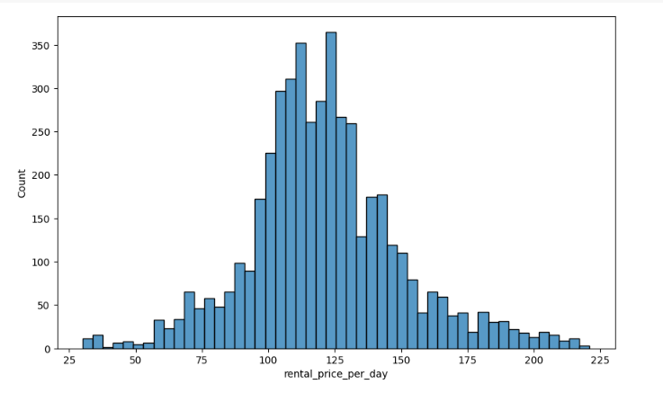
PRICING DISTRIBUTION:
We began by exploring the distribution of rental prices. The histogram revealed that the majority of rentals cost between 100 to 150 per day, providing a baseline understanding of the pricing structure on GetAround.

Slide 5
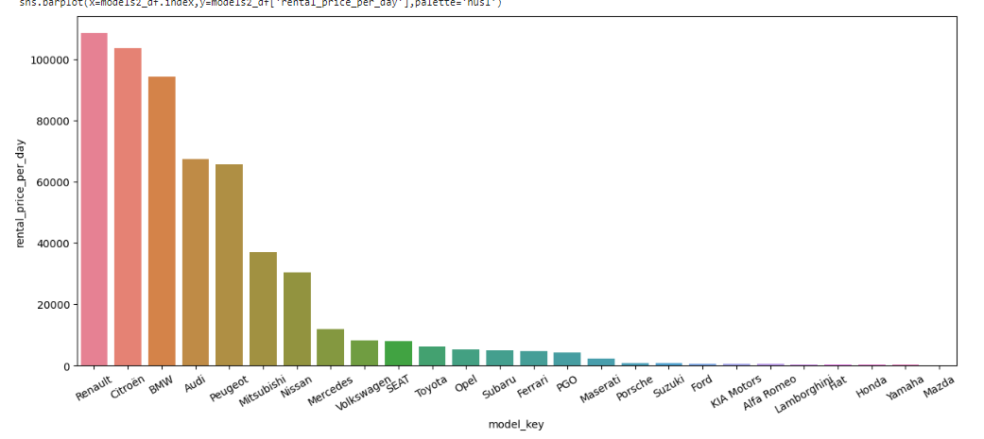
TOP EARNING CAR MODELS:
This chart shows how much money our top car models make. Even though brands like Renault, Citroën, BMW, Audi, and Peugeot have lower prices, they bring in more than 75% of our rental income. This tells us that these popular brands are really important for our business.

Slide 6
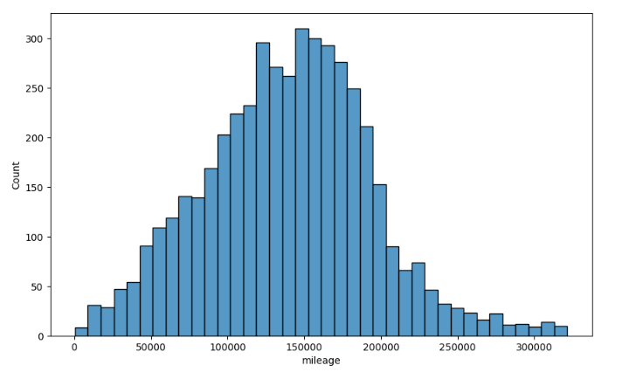
MILEAGE ANALYSIS
A subsequent analysis focused on the mileage of available cars. The histogram indicated that while many cars are not new, only a few have more than 200,000 kms

Slide 7

DELAY ANALYSIS
We categorized the delays at checkout into different groups, such as 'Early,' 'Late 0-15,' 'Very late,' and others. Here are the counts for each category:
Early: 6820
NA (Not Available): 4964
Very late: 2568
Late 0-15: 2003
Late 60-120: 1860
Late 30-60: 1722
Late 15-30: 1373

Slide 8
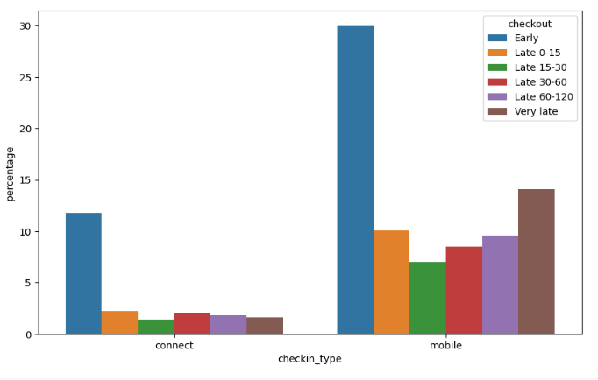
CHECKOUT IMPACT ANALYSIS
This chart breaks down the percentage distribution of different checkout types (Connect and Mobile) and their outcomes (successful and canceled). The visual representation helps understand the impact of checkout types on the overall rental process.

Slide 9
LATE CHECKOUT ANALYSIS
On average, approximately 43.36% of drivers experience delays during the checkout process.
For those who are late, the average delay is around 124.32 minutes.
Understanding the prevalence and duration of late checkouts is crucial for improving operational efficiency and enhancing customer satisfaction.

Slide 10
MODELLING
Part 2

Slide 11
INTRODUCTION:
We Splitted this project into Two Parts EDA & MODELLING:
In this exploratory data analysis (EDA) of GetAround, our primary objective was to gain insights into rental patterns, pricing distribution, and the impact of delays on the platform. Through a detailed examination of two datasets, we aimed to uncover key trends, challenges, and potential areas for optimization.

Slide 12
DATA PREPROCESSING:
loading the dataset and splitting it into features (X) and the target variable (Y). The features include both numeric (e.g., mileage, engine power) and categorical variables (e.g., model_key, fuel, paint_color).
Numeric features are standardized using StandardScaler, and categorical features are one-hot encoded using OneHotEncoder.

Slide 13
REGRESSION BASELINE:
A Linear Regression model is trained as a baseline. The model achieves an R-squared score of approximately 0.71 on both the training and test sets. This baseline serves as a reference for the subsequent model evaluation.
f1-score on train set : 0.7156711732458418
f1-score on test set : 0.7117892771783902

Slide 14
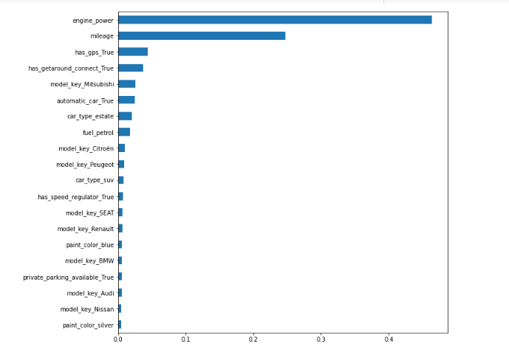
GRADIENT BOOSTING REGRESSOR:
A Gradient Boosting Regressor is implemented and fine-tuned using GridSearchCV to find optimal hyperparameters. The best configuration achieves an R-squared score of 0.77 on the training set and 0.78 on the test set, outperforming the linear baseline.
Feature importance are visualized, indicating that the model places higher importance on engine power than mileage.

Slide 15
BUILDING THE API:
The trained Gradient Boosting Regressor model and the preprocessor are saved using joblib.dump.
he model and preprocessor are loaded, and a sample prediction is obtained by making a POST request to the API endpoint (http://localhost:8000/predict). The response provides the predicted rental price per day.
Overall, the modeling process involves data preprocessing, training a regression baseline, implementing a Gradient Boosting Regressor, and preparing an API for real-time predictions..

Slide 16
CONCLUSION:
In summary, our exploration of the car rental data uncovered valuable insights. We identified trends in rental patterns, checkout delays, and potential areas for improvement. The machine learning models we developed offer predictions for rental pricing. Our recommendations include setting a delay threshold to enhance user experience and optimize business outcomes. By implementing these findings and continually refining strategies, we aim to boost overall business performance.

